Slide 1

Employee Wellness Analysis
STUDENT NAME : SASHMITHA B
REGISTER NUMBER : 312219022
DEPARTMENT : III B.COM [GENERAL]
COLLEGE NAME : APOLLO ARTS AND SCIENCE COLLEGE CHENNAI

Slide 2

Employee wellness analysis
Employee Wellness Analysis

Slide 3

Introduction:
Objective:
To analyze current employee wellness levels
To identify areas for improvement
To propose strategies for enhancing employee well-being

Slide 4

Importance of Employee Wellness:
Definition:
Employee wellness encompasses physical, mental, and emotional health.
Benefits:
Increased productivity
Reduced absenteeism
Enhanced employee engagement and satisfaction
Lower healthcare costs

Slide 5

Key Components of Employee Wellness:
Physical Wellness:
Health programs (e.g., gym memberships, health screenings)
Mental Wellness:
Stress management, mental health resources
Emotional Wellness:
Work-life balance, supportive work environment
Social Wellness:
Team-building activities, social support systems

Slide 6

Identified Challenges:
Physical Health Issues:
Common health concerns among employees
Mental Health Concerns:
Levels of stress, burnout rates
Work-Life Balance:
Feedback on work hours, flexibility

Slide 7
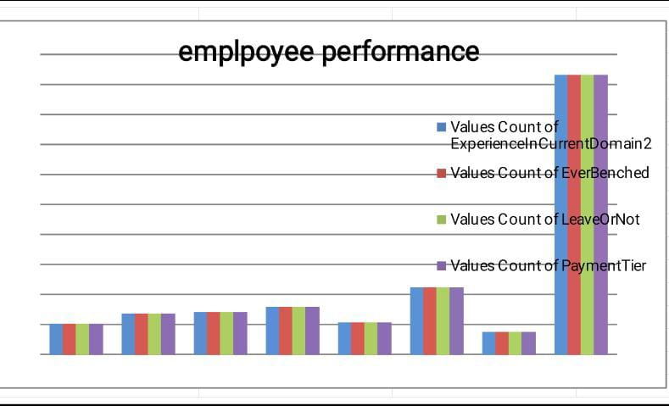

Slide 8

Benefits of a Wellness Program:
For Employees
Improved health and reduced risk of chronic diseases.
Enhanced job satisfaction and morale.
Better work-life balance.
For Employers
Increased productivity and engagement.
Lower healthcare costs and reduced absenteeism.
Attraction and retention of talent.

Slide 9

Implementing a Wellness Program:
Assessment and Planning
Conduct employee surveys to understand needs.
Define clear objectives and goals.
Program Design
Develop a range of initiatives based on employee needs.
Ensure inclusivity and accessibility.
Execution and Communication
Launch the program with a clear communication plan.
Provide training and resources for managers.

Slide 10

Wellness Program Examples:
Fitness Initiatives
On-site gym or fitness classes.
Subsidized gym memberships.
Mental Health Support
Employee Assistance Programs (EAPs).
Workshops on stress management and mindfulness.
Nutritional Support
Healthy snacks and meal options.
Nutrition workshops and consultations.

Slide 11

Challenges and Solutions:
Common Challenges
Low participation rates.
Budget constraints.
Diverse employee needs.
Solutions
Tailor programs to various employee segments.
Start with pilot programs to demonstrate value.
Secure executive support and involvement.

Slide 12

Conclusion:
Summary of Key Points
The critical role of wellness programs in enhancing employee well-being.
Benefits for both employees and employers.
Effective implementation strategies and measurement of success.
Call to Action
Encourage leadership to invest in wellness initiatives.
Promote an ongoing commitment to employee health and well-being.

Slide 13


